Slide 1
Local Authority Internal Audit Forum Risk in Focus 2021
Liz Sandwith CFIIA
Chief Professional Practices Adviser
28 October 2020

Slide 2
Risk in Focus 2021
Risk in Focus is an annual barometer of what Chief Audit Executives (CAEs) perceive as their organisations’ risk priorities and what is preoccupying their thinking as they prepare their forthcoming audit plans.
The fifth edition of Risk in Focus is the result of a partnership between ten European institutes of internal auditors: Austria, Belgium, France, Germany, Italy Luxembourg, the Netherlands, Spain, Sweden and the UK & Ireland.
Risk in Focus is an essential point of reference for the internal audit profession, not just in Europe where the research is carried out, but worldwide.
A number of key risks have been exacerbated including; cybersecurity and data security, financial, capital and liquidity risks, and bribery fraud and other financial crime.
The report sets out a number of recommendations on how organisations can tackle these risks and the role of internal audit in managing and mitigating these risks.
Coronavirus is the most significant and far-reaching event for businesses and has continued to disrupt the corporate landscape.
Notes:
Risk in Focus 2020 contains the results and analysis of hundreds of survey responses and in-depth interviews with Chief Internal Auditors working across Europe.
The report also includes topical and high-level guidance on tackling the biggest risks facing organisations.
The report you have in front of you this morning is a collaboration with eight European institutes of internal auditors and it is the fourth annual report of its kind since 2016, a project which continues to go from strength to strength.
In that short space of time, Risk in Focus has become a vital point of reference for internal auditors.

Slide 3
Risk in Focus 2021 - methodology
The quantitative survey saw 579 responses, a 10% annual increase and the highest response rate since the survey began.
Risk in Focus also draws upon 42 in-depth interviews with CAEs and for the first time ever, Audit Committee Chairs.
In another first, research includes perspectives from 51 subject matter experts on developing risk areas.
Notes:
The survey and interviews the research is based on, means that Risk in Focus 2020 provides a unique and invaluable insight into the biggest risks faced by organisations.
This year 528 Chief Internal Auditors took part in the survey, including 125 from the UK and Ireland. It’s great that the number of survey respondents has increased by 70% in the last year which has only added to the value of this new data about the top business risks.
Comments from Chief Internal Auditors appear throughout the document from the in-depth interviews. They provide a unique and valuable insight into how some of the biggest organisations in Europe are responding to their major risks.

Slide 4
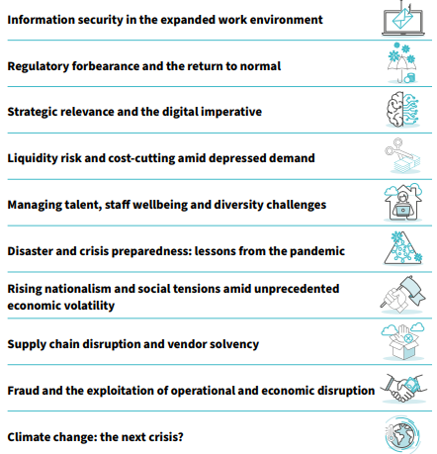
Risk in Focus 2021 - this year’s hot topics
1.
2.
New risk – disaster and crisis preparedness: lessons from the pandemic – is this a one off or will it now stay but link to future potential disasters e.g. climate change
Differentiation between strategic and operational risks
3.
4.
5.
6.
7.
8.
9.
10.
Notes:
The Risk in Focus 2020 report is made up of 10 hot topics.
In each of the hot topics you will find three things:
Detailed information about the survey results.
Direct quotes from Chief Internal Auditors about what is preoccupying their thinking as they prepare their audit plans.
Guidance for organisations about how to tackle the major risks outlined in the report.

Slide 5
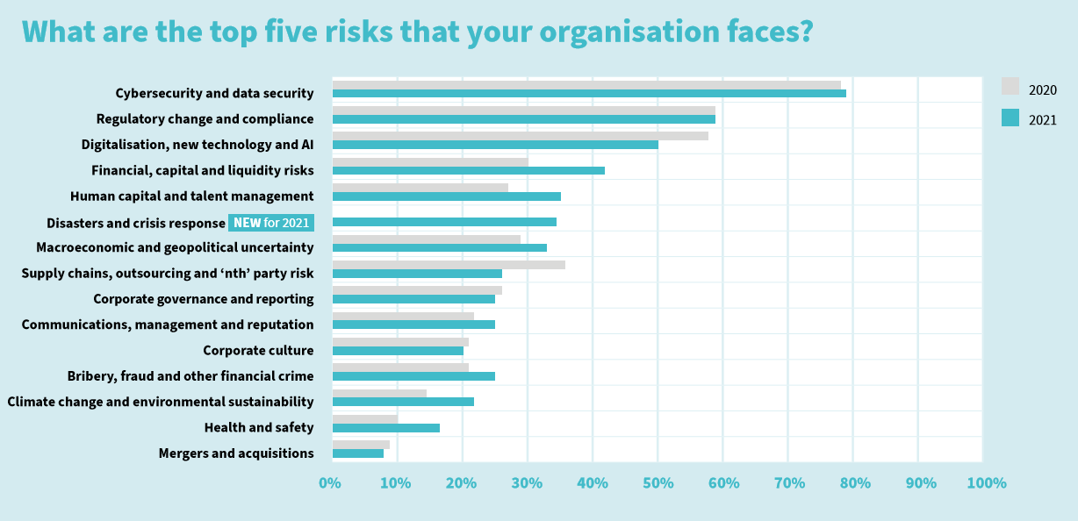
Key Messages - One Year on 2021 vs 2020
Cybersecurity – number 1
New risk - disaster and crisis response
Changes in emphasis 2020 vs 2021
Recognition of the COVID-19 impact
Surprises?

Slide 6
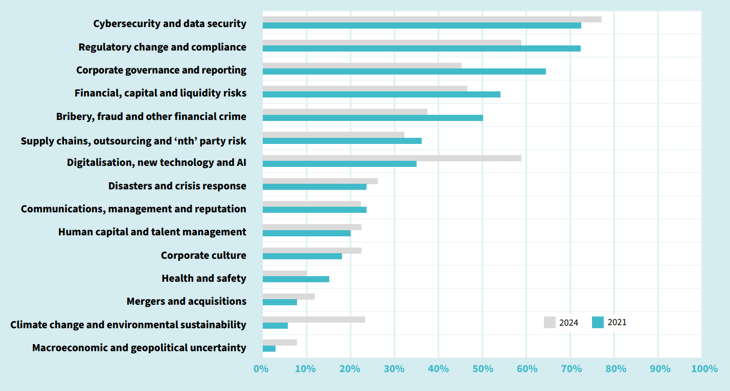
Time spent auditing vs the priority of the risk
Does this resonate and does your internal audit activity have the future capacity and capability in terms of these risks?
Are we surprised by
Climate Change,
Human Capital, Macroeconomic and geopolitical uncertainty
Mergers and acquisitions
Corporate culture
Digitalisation, new technology and AI
Cybersecurity
Might there be an expectation that we have started to mitigate these risks and they become BAU?

Slide 7
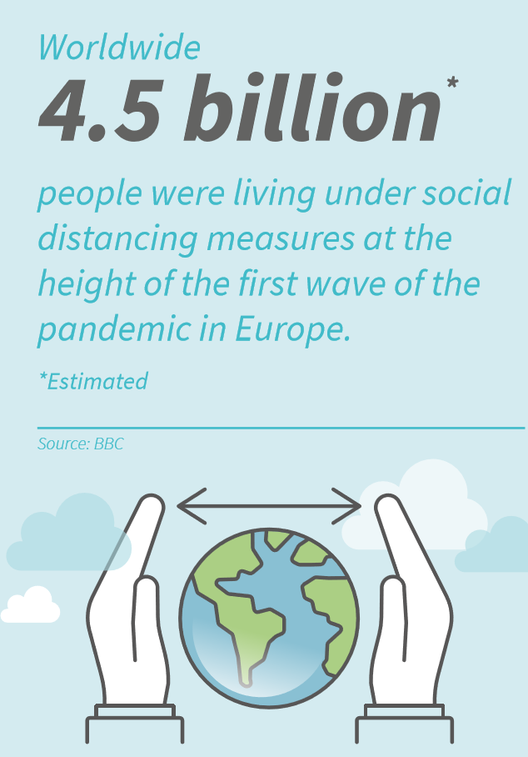
Information security in the expanded work environment
For the third year running, cybersecurity and data security has topped the list of risks with 79% of CAEs voting for it as a top five risk for their organisation.
More than a quarter (27%) have singled it as their number one risk.
The overnight shift to remote working during lockdowns has increased organisations vulnerability to cyber-attacks.
Mitigating risks of remote access to sensitive data by securing homeworking devices.
Staff have become more susceptible to social engineering ploys and greater risk of controls and safety measures getting circumvented.
How has the newly expanded work environment impacted the IT controls system in different parts of the authority and what risks does this pose?
Is the first or second line testing staff awareness with friendly phishing attempts? Should internal audit test IT defences independently, perhaps with the assistance of a co-sourcing partner?
Has the authority performed a risk assessment to identify possible network weaknesses and data assets whose susceptibility to attacks and theft has increased in the last 12 months?

Slide 8
Regulatory forbearance and the return to normal
For 59% of audit executives in our survey Regulatory change and compliance is a top five risk to their organisation, exactly matching the result from last year, a clear indication that compliance is an evergreen risk.
The regulatory burden was eased in the first half of 2020 to give companies breathing space as they contended with the immense challenges posed to their staff and operations by the GCP.
Financial reporting deadlines were pushed back, and the European Banking Authority delayed until 2021 its scheduled bank stress tests.
Data authorities have taken a less punitive approach by issuing fewer fines related to GDPR violations.
But regulatory forbearance is only temporary and is by no means absolute. Existing regulations remain in force, even if they have not been as aggressively enforced in recent months.
There may have been a temptation among companies to take their eye off the ball in 2020 causing compliance standards to slip or the organisation to fall behind after regulatory deadlines were postponed until 2021.
To what extent has the pandemic and the authority’s efforts to remain operational amid the disruption impacted its compliance risk? Have staff been taking shortcuts that pose possible conduct and other regulatory breaches?
Is the authority prepared for regulators to roll back any forbearance and increase their oversight in 2021?
Should internal audit conduct an independent regulatory risk assessment and see how closely it matches the second line’s assessment?

Slide 9
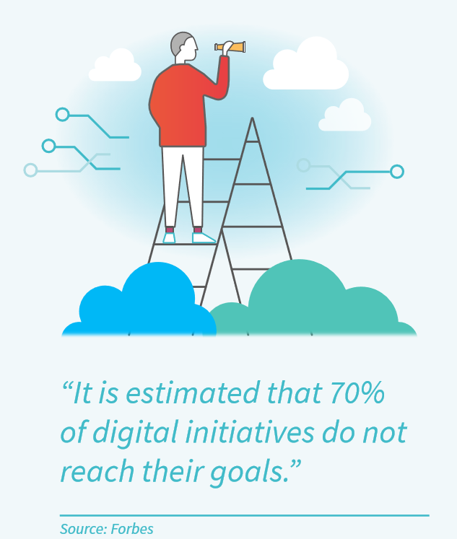
Strategic relevance and the digital imperative
Half of CAEs (50%) see Digitalisation, new technology and AI as one of the top five risks their organisations face, down from 58% a year ago.
This fall may reflect the shift in attention to the shorter-term impacts of the coronavirus pandemic as digital transformation projects are disrupted.
Indeed, 67% of audit executives expect this to be a top five risk to their organisation in three years’ time, indicating an only temporary lull of this risk priority.
The events of 2020 have magnified the digital imperative, making such transformations a more pressing priority by driving home the value of digital products and services and the flexibility companies can achieve by digitalising their operations.
Lockdown and distancing measures atomised organisations, hindering collaboration efforts for those companies not used to operating under remote conditions.
Many businesses will also struggle with their many priorities as they concentrate on managing other crisis-related challenges.
Does management have a clear view on which innovation projects are critical to ensuring the strategic relevance and future viability of the authority and have they been appropriately resourced?
Does the technology and data that is fundamental to enabling the authority’s operations and strategy work as expected?
Can the authority successfully manage projects and change? Have lessons been learned from the
success or failure of past projects? What evidence is there of this?

Slide 10
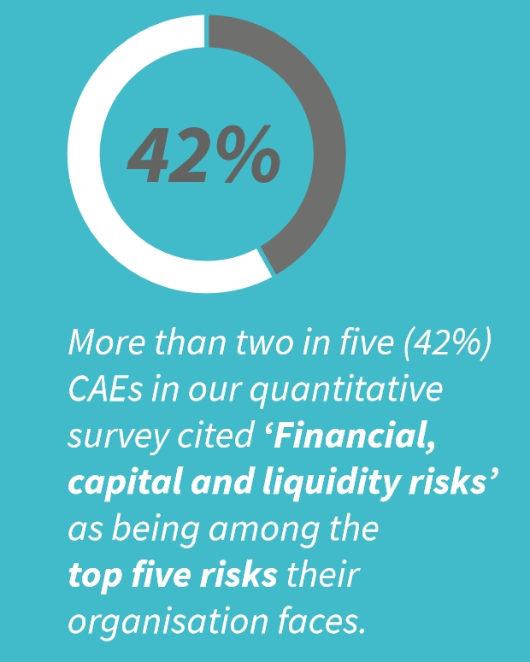
Liquidity risk and cost-cutting amid depressed demand
Financial, capital and liquidity risk has jumped up the agenda with more than two in five (42%) of CAEs surveyed who said that it’s in their top five risks – a 40% increase on last year.
This is a likely consequence of the timing of the survey in March, when the coronavirus outbreak reached Europe and short term liquidity risk spiked.
Short-term risks may abate by 2021 but board/audit committee could seek treasury audits to confirm risks are being managed.
In the medium-term internal audit can add value in helping to rein in costs and supporting the organisation analysing business operation for gaps and inefficiencies to deliver savings.
Can internal audit help the authority identify operational efficiencies and gaps that can be closed to make long-term cost savings?
Have longer-term liquidity and financial risks been addressed, such as access to necessary refinancing when loan and bond terms expire?
Has senior management made or proposed cost-cutting measures? If so, to what extent are these likely to cause disruptions and has this been accounted for?
How successful have the treasury and CFO been in their efforts to manage the authority’s liquidity risks?

Slide 11
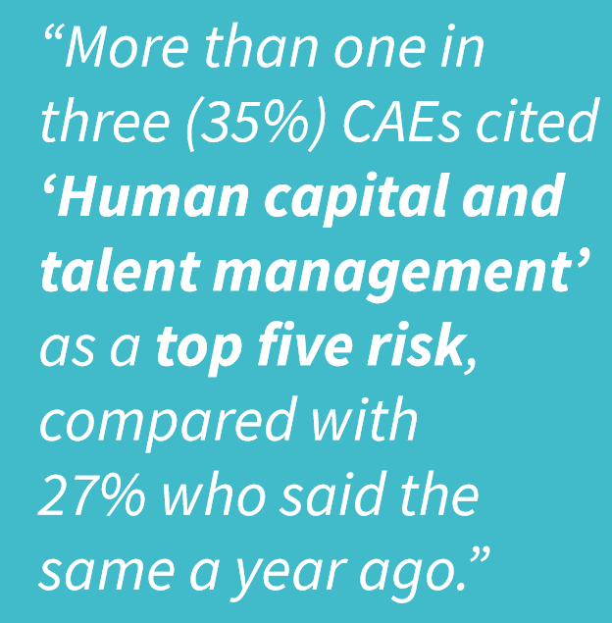
Managing talent, staff wellbeing and diversity challenges
Managing talent, staff wellbeing and diversity challenges has risen up the agenda, with more than one in three (35%) citing ‘Human capital and talent management’ as a top five risk, compared with around one in four (27%) who said the same a year ago.
The pandemic has accelerated the evolution of flexible working arrangements.
Health and safety saw a 70% year-on-year increase in the numbers of businesses citing it as a priority. Almost one in five participants (17%) said it was a top five risk, compared with only 10% a year ago.
Making workplaces COVID secure, mental wellbeing of staff during prolonged isolation and the renewed significance of the diversity agenda.
How does the authority define and manage its human capital and talent management needs and risk?
Is the HR/workforce strategy aligned with the corporate strategy, culture and values and do they inform each other?
What processes and policies are in place that ensure the fair treatment of staff? Are there any biases that result in the unequal treatment of workers, especially with regards to race, gender, religion and sexual orientation?
Does the authority’s workforce diversity reflect its publicly espoused values?

Slide 12
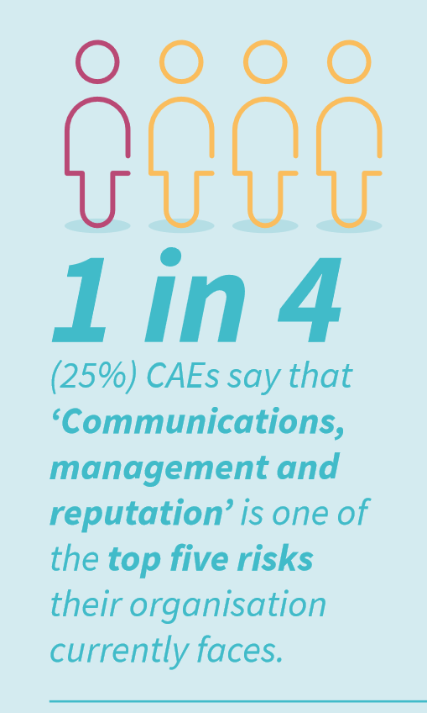
Disaster and crisis preparedness
For the first time ever, Disasters and crisis response has been included in the survey.
Over a third of CAEs (34%) cited it as a top five risk to their organisation, reflecting the increased focus on crisis management and business resilience as a result of the coronavirus pandemic.
Organisations assessing effectiveness of BCPs, to what extent they were followed and the robustness of the governance around crisis time decision-making.
Similarly crisis management and planning need to be updated for future pandemics and the more lockdowns that may follow.
Reputations also have been at stake, with one in four (25%) CAEs citing Communications, management and reputation as a top five risk.
How effective was the authority in responding and adapting to the pandemic?
Has the business continuity plan been updated to include a global pandemic scenario and its related challenges? Does the plan now include and cover all possible external risk events? Are the various scenarios and BCP arrangements tested?
Are crisis communications procedures set out in the BCP that apply to both staff and external stakeholders such as customers, suppliers and stakeholders?

Slide 13
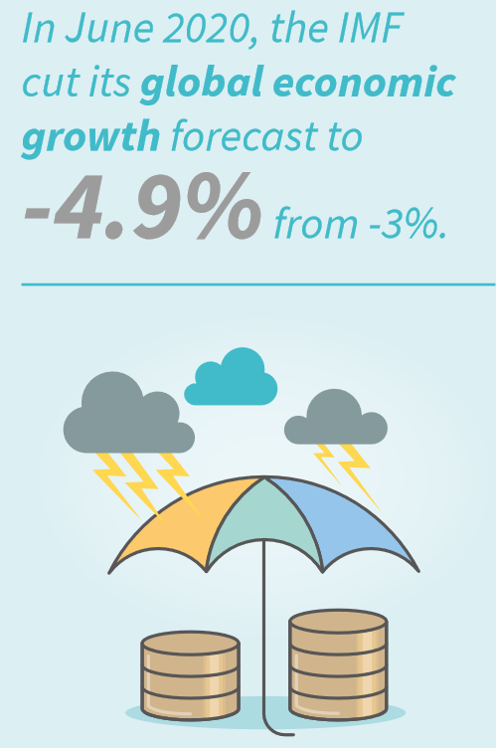
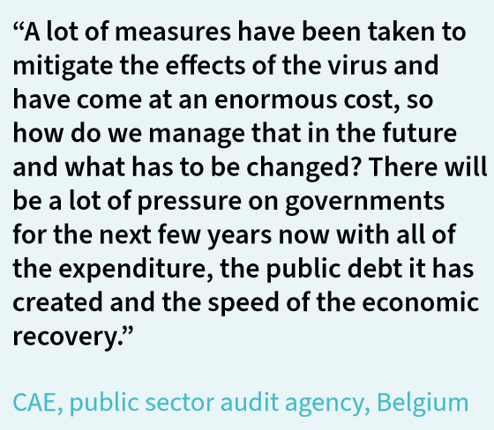
Rising nationalism and social tensions amid unprecedented economic volatility
33% of CAEs said that macroeconomic and geopolitical uncertainty was a top five risk, in comparison to the 29% of CAEs who said the same a year ago.
Growing uncertainty on whether the UK can agree a trade deal with the EU following Brexit.
A number of developments widened gap between the West and China.
One of the most obvious impacts of the GCP outside of the threat to public health is one of the deepest economic recessions in recorded history and it is not clear to what extent this will carry over into 2021.
Economic challenges and high unemployment may add to already high levels of social unrest and civil disobedience. This makes the macro environment more unforgiving than it has been for decades.
Are carefully substantiated continuity/resilience plans in place should politically motivated trade measures escalate?
Are macroeconomic and geopolitical risks factored into the company’s business strategy and decision making?

Slide 14
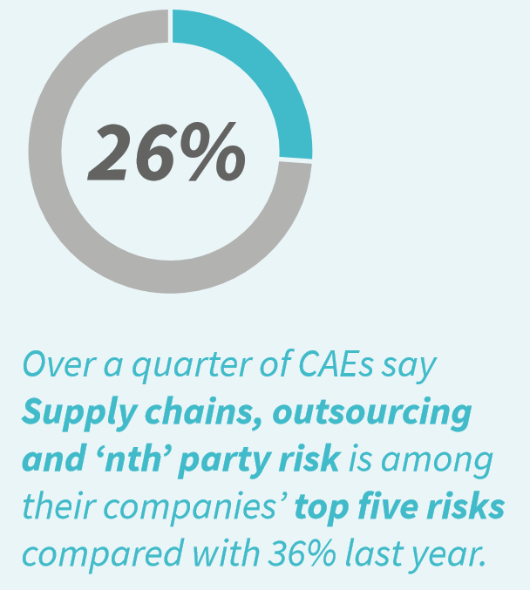
Supply chain disruption and vendor solvency
Although supply chains have come under considerable stress, only 26% of CAEs say Supply chains, outsourcing and ‘nth’ party risk is among their companies’ top five risks, compared with 36% last year.
China overcame its first wave of coronavirus relatively quickly and initial concerns amid the GCP’s early weeks quickly turned from supply to demand.
The ability to meet depressed levels of demand with available supply may have given many companies a false sense of security.
It should not be forgotten that the financial and liquidity risks that rise in a downmarket apply to key vendors too.
Businesses and internal audit should be mindful of the solvency of core suppliers and outsourcing partners, and the ongoing ability to stock appropriate levels of inventory to meet demand
Have alternative suppliers of key materials and components been identified and put on standby?
How has any volatility as a result of the GCP impacted the supply chain and what has the authority done to mitigate these effects in future?
How is the authority's supply chain and outsourcing risk determined and have risk assessments been updated post pandemic?

Slide 15
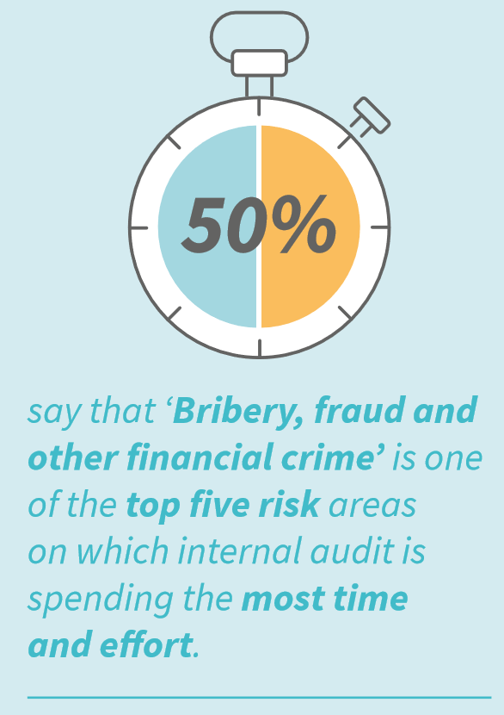
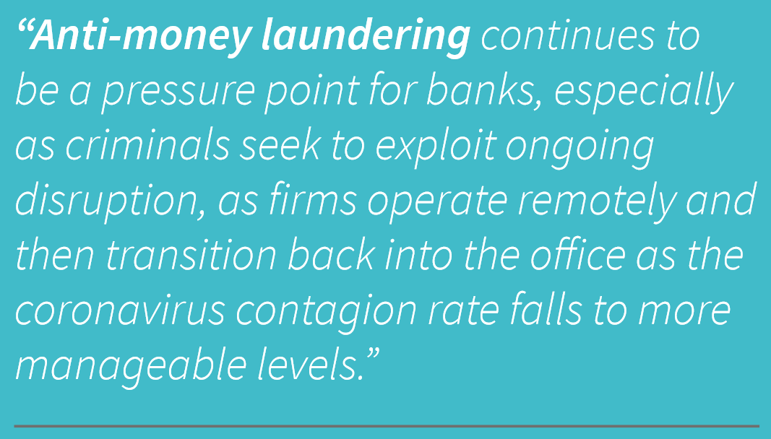
Fraud and the exploitation of economic and operational disruption
Bribery, fraud and other financial crime was cited by 25% of CAEs as a top five risk, a notable 19% increase on the 21% who said that same a year ago.
50% said that that this is an area where audit is spending most time and effort.
Two main forces putting businesses at heighted risk of financial crime:
Increase in fraudsters attempting to capitalise on the crisis using sophisticated digital techniques.
Efficacy of controls is likely to have been weakened in recent months due to the ongoing pandemic.
Do the highest ethical standards continue to be promoted from the top down throughout the authority? Is senior management leading by example?
Are these controls updated to cope with the increase of sophisticated digital techniques used to commit fraud and other financial crime?
Has the monitoring and follow-up of suspicious transactions changed in any way? Has full monitoring capacity since been reinstated or is there a plan to do so?

Slide 16
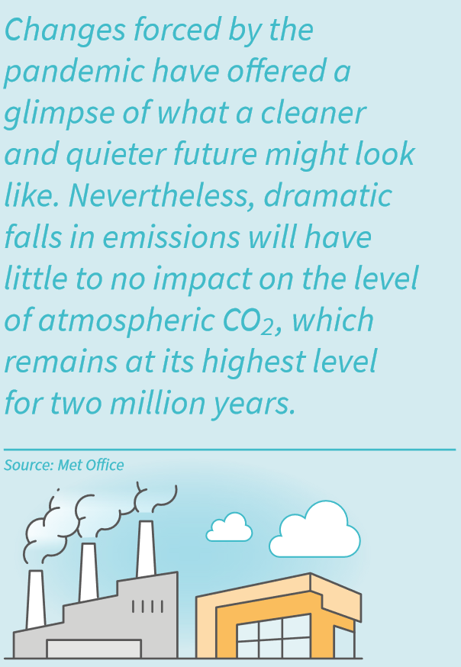
Climate change: the next crisis?
22% of CAEs cited climate change and environmental sustainability as one of their top five risks that their organisation faces.
But, only 6% of CAEs cite climate change as one of the top areas on which they currently spend most time and effort.
41% of CAEs have said that they expect it to be a top five risk to their organisation three years from now.
No other risk is expected to gain more in priority over this period.
The extent of preparation needed is evident from the coronavirus pandemic.
Have climate change and sustainability risks been identified by senior management and factored into the strategy-making process of the authority? Are these risks periodically reviewed?
How does the authority measure and report its progress in reaching its sustainability goals and reducing its environmental impact? Should internal audit review the reliability of these reports?
Does the authority have the appropriate culture required to become a green authority and fulfil its sustainability ambitions? Is there buy-in at all levels to achieve these goals?

Slide 17
Reflection / context?
The unprecedented circumstances of the GCP, the biggest global risk event in recent memory, has undoubtedly shaped the outlook for 2021.
Coronavirus itself is not a principal risk.
Rather than posing new threats, coronavirus has exacerbated existing risks, putting them in a new light and forcing organisations to think about them from different angles or assign to them new levels of priority.
Cyber and data security is a perennial front-of-mind risk for governance committees and senior management.
Widespread homeworking has meant that cybersecurity has taken on a new dimension, inevitably, phishing attempts and social engineering incidents have soared as attempts to exploit security weaknesses followed the decampment of staff into their homes.
Internal audit must be forward-looking, proactive and continue to stay as close to the business as possible to understand both its risks and its needs.
Increasingly, this involves not only operational considerations but strategic risks and factors in the external environment acting upon the organisation.
Now is the time for internal audit to prove its worth.

Slide 18
Thoughts, questions?

